Slide 1
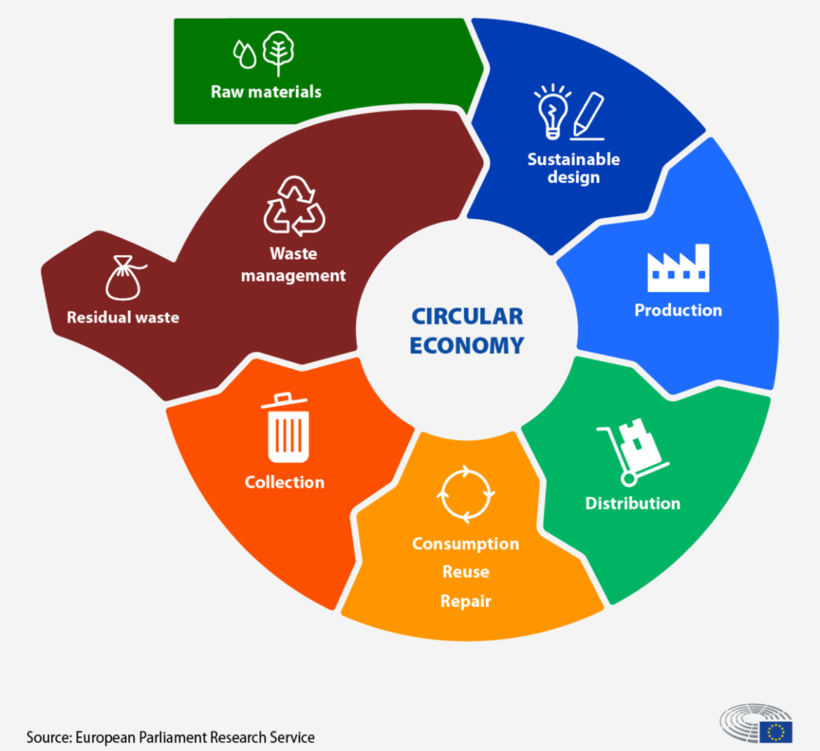
Understanding the Circular Economy

Slide 2
What to know before starting?
What will you learn?
How much time will it take?
30 minutes
Define the circular economy and its core principles.
EQF level
Level 3
Identify the environmental and economic benefits of a circular economy.
Who created the content and will recognise your learning?
Recognize the challenges and limitations of implementing a circular economy
This material was created by the partners of the Erasmus+ project “Upskilling Rural” that will recognise your learning as well.

Slide 3
Let’s understand the EU Green Deal
https://youtube.com/shorts/xRZWEG2FYZI?si=amUWAuPm--HOyYIe

Slide 4
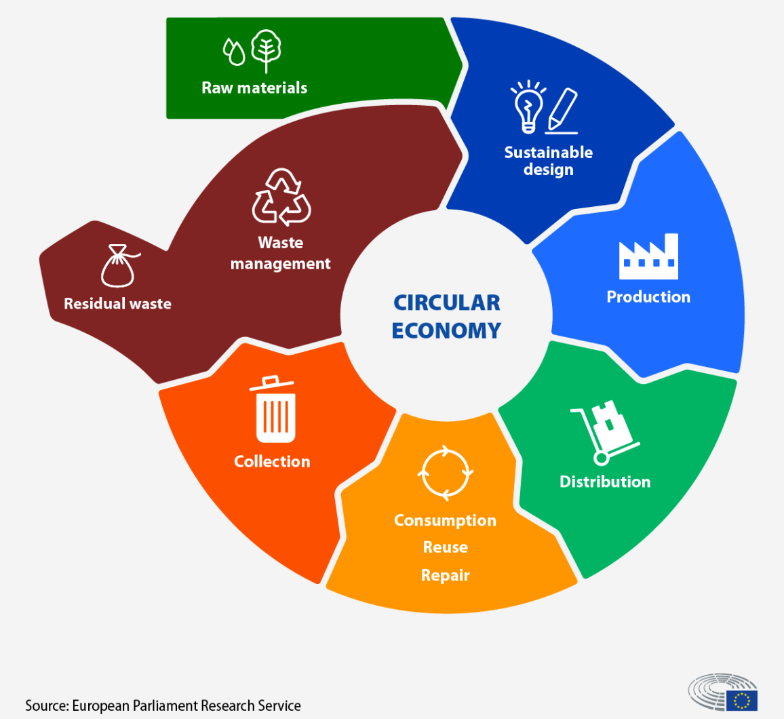
The “Circular Economy” Model
DEFINITION: it is a model of production and consumption that has the objective of extending the life cycle of products, in order to minimize waste and create more value.
The objective is to contrast the linear model of consumption – model based on products of limited lifespan that encourage consumers to buy again. These products are often produced in large quantities with easily accessible materials and energy.
The circular economy model is at the basis of the EU Green Deal policy.

Slide 5
The 5 R principle
The concept of the circular economy is based on the “5 R principle”.
Reduce: limited resources means to reduce consumption and chose alternatives like rent or borrow when possible.
Reuse: the circular economy model is based on the idea of creating items that can be used in different way to extend their lifecycle. Adapting items to different uses is crucial for this type of model.
Repair: the model wants to promote the creation of items with materials that can be replaced, giving new life to items and avoid over-consumption.
Rethink: the model wants to promote a “think outside the box” scheme thinking for alternative uses of items to reduce consumption.
Recycle: Used materials that are considered waste should be recycled to be able to be transformed in new ones.

Slide 6
The Benefits of the Circular Economy
Environmental protection – the application of the circular economy model would have impact on both reduction of greenhouse gas emissions and slow down the use of natural resources.
Reduce raw materials dependence – raw materials (i.e. Natural Gas, Oil, Wood, etc.) are limited and not available to everybody. Recycling raw materials is an excellent way to reduce dependence even on an economic point of view.
Saving money – the circular economy has the objective of stimulating innovation across different sectors of the economy, giving consumers more durable and reusable products, reducing consumption and expenses.
Think: can you think of other benefits the circular economy can bring?

Slide 7
Circular Economy in Rural Areas
The current economic and production systems are very dependent from the environment. Circular economy consider waste a crucial resource that must be integrated.
Application of this model requires the collaboration of people, policies and places:
People are crucial in this model, their behaviour and their choices influence the way models are applied to real life. Application of a new model implies behavioural and cultural shift.
Policies on local, national and EU levels are being created to make the application easier for people and businesses. One of the most important policies is the «Europe Green Deal».
Places are different and have different needs. Big cities have different needs than smaller rural centres. It is key to consider the characteristic of each to have a good application.

Slide 8
Circular Economy in Rural Areas
Rural areas can benefit from the application of this model in terms of:
Producing renewable energy from local activities (example energy for agriculture from agricultural waste)
Fostering bio-diversity with diversified farming practices (example in Abruzzo, region in Central Italy rural businesses are investing in the cultivation of ancient types of wheat that are eco-sustainable and profitable)
Promoting sustainable tourism (example sale of local products and sustainable production)

Slide 9
The Product as Service Model (PaaS)
A Business model that applies the principle of circular economy and that can be adapted to rural areas is the Product As Service Model. (PaaS)
Companies offer access to a product functionality or outcomes, but the customer does not own the product, the company does. The customer pays a subscription to use the product and the company offers also mantainance, repair and update.
The PaaS model can be adapted also to rural areas.

Slide 10
The Product as Service Model
Benefits
Customers
Lower big costs
Reduce mantainance costs
Easy access to updgrades
Businesses
Recurring revenue (connected to subsctiption)
Stronger relationship with customers
Committment to quality

Slide 11
The PaaS Model in Rural Areas
This model in rural areas can help:
Overcome limited resources – this includes money and skills. The model offers access to services and equipment without ownership
Improved sustainability – the PaaS model ecourages businesses to provide durable, hig-quality products
Innovation and technology access - PaaS can introduce innovative technologies like precision agriculture equipment or renewable energy solutions to rural areas with a lower investment, accelerating development.

Slide 12
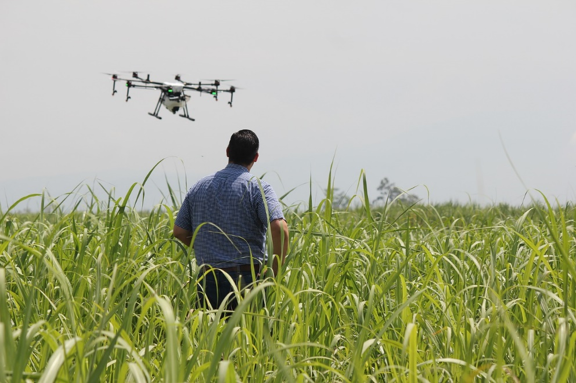
The PaaS Model in Rural Areas
Practical examples:
Precision agriculture tools (i.e. drones, sensors) Farmers pay only for the time they use the equipment and benefit from expert support
Leasing of green printers or green equipment.

Slide 13
Sources
https://www.oecd-ilibrary.org/sites/bee1dd72-en/index.html?itemId=/content/component/bee1dd72-en
https://www.europarl.europa.eu/topics/en/article/20151201STO05603/circular-economy-definition-importance-and-benefits
https://www.regeneration2030.org/post/the-great-five-r-s-of-circular-economy
https://multitraces.ub.ro/files/IO/IP1/O1_Chapter_2_Circular_economy_in_rural_areas_R.pdf
https://energy.ec.europa.eu/topics/markets-and-consumers/energy-communities_en
https://www.ellenmacarthurfoundation.org/circular-examples/the-eus-circular-economy-action-plan

