Slide 1
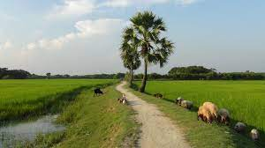
Employability in Rural Tourism Entrepreneurship – part 1

Slide 2
What to know before starting?
What will you learn?
How much time will it take?
10 minutes
Explore the local and regional nature.
EQF level
Achieve farm-to table experience.
Level 3
Provide examples of eco-friendly practices.
Who created the content and will recognise your learning?
This material was created by the partners of the Erasmus+ project “Upskilling Rural”.

Slide 3
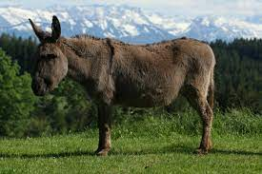
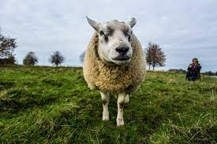
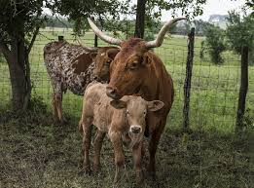
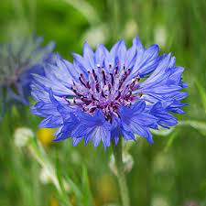
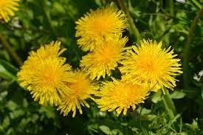
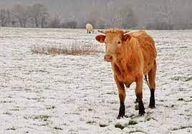
Let’s start... but first think…
What local flora and fauna have you seen live? (you may know about them, but never seen them ☺
https://www.youtube.com/watch?v=MfwcAM-MlYQ
https://www.youtube.com/watch?v=X985LDeK2yo

Slide 4
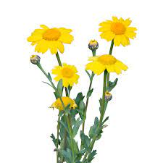
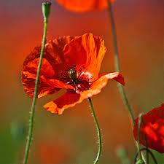
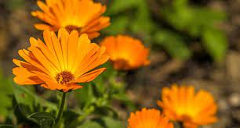
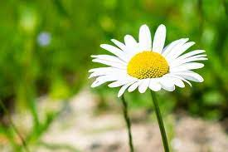
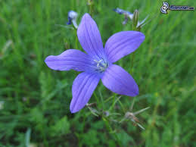
Flora in rural area
Flowers on a meadow – some incredible information
Blue wildflower
Blue wildflowers have rich symbolism and cultural significance across different cultures. For instance, the bluebell is often associated with humility and gratitude in British folklore, while in Victorian times, giving a blue wildflower could symbolize constancy and everlasting love. In literature and art, these flowers frequently represent tranquility, inspiration, and the beauty of nature.
Goldenrod
Poppy
Marigold
Marigolds are renowned for their ability to act as a natural pest repellent in gardens. They produce a substance called thiophene, which is toxic to many soil-dwelling pests such as nematodes and certain insects. Planting marigolds alongside vegetables and other plants can help protect them from these harmful pests, reducing the need for chemical pesticides. This natural defense mechanism not only aids in sustainable gardening practices but also promotes healthier plant growth.
Chamomile
Field roe
Chamomile is renowned for its wide-ranging medicinal benefits, which have been utilized for centuries. One of the most popular uses is its calming effect when brewed as tea, helping to alleviate anxiety, promote sleep, and soothe digestive issues. Chamomile contains compounds such as apigenin, which binds to receptors in the brain to decrease anxiety and induce relaxation
Clover

Slide 5
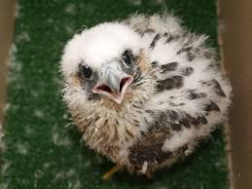
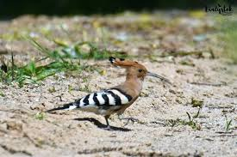
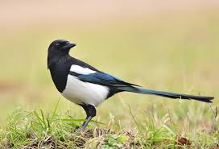
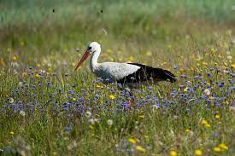
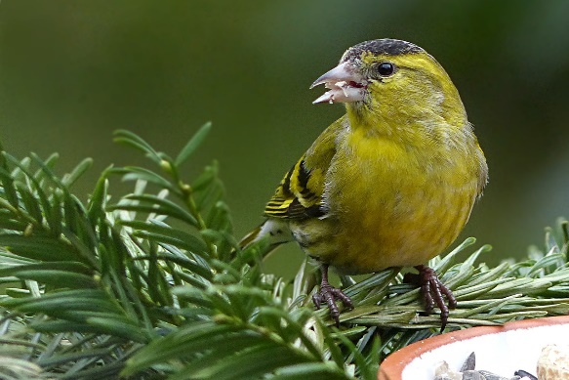
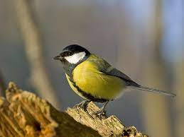
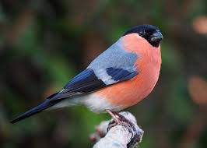
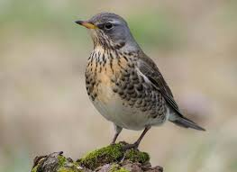
Falcon
Fauna in rural area
Animals, surely you know them….but the birds? ☺
https://www.youtube.com/watch?v=4VYObk8e6N4
Hoopoe
Magpie
Stork
https://www.youtube.com/watch?v=mERIvytIcpQ
Lurk
Common godwit
Gila
Quack
https://www.youtube.com/watch?v=ltzhV-j86DU

Slide 6
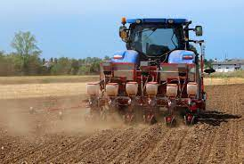
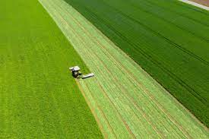
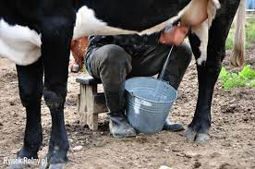
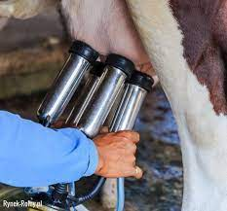
Agricultural activities
What can you do on a farm? ☺
Ploughing the field is to turn over the upper layer of the soil, bringing fresh nutrients to the surface, while burying weeds and the remains of previous crops and allowing them to break down.
Mowing the field is best on cloudy but rainless days. Mowing in full sun is not conducive to proper hydration. Grass should also not be cut when it rains.
Watch the movie: https://www.youtube.com/watch?v=D7nKsRXaC_Q
Milking cows involves closing the upper part of the teat canal with the thumb and forefinger, clamping the fingers encompassing the teat at its base, then pressing the remaining fingers against the teat one by one, squeezing the milk outwards.
Watch the movie: https://www.youtube.com/watch?v=Gr9uRRYRWas
Automated milking cows
Watch the movie: https://www.youtube.com/watch?v=R9SEaUHYkr4

