Slide 1
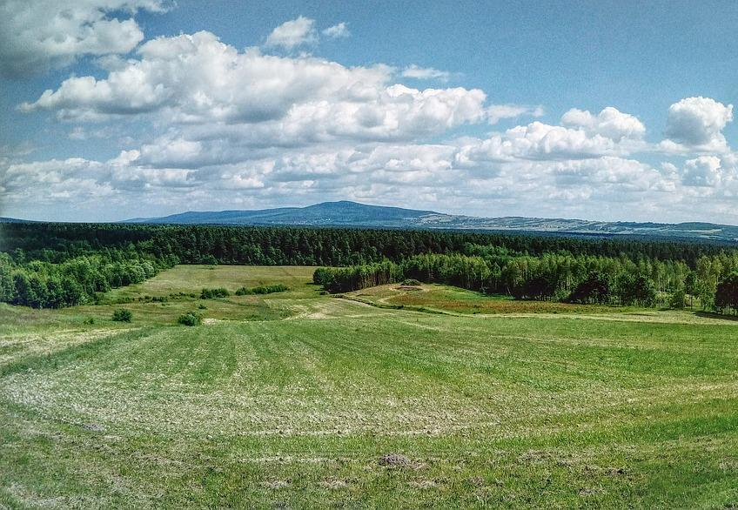
Employability in Rural Tourism Entrepreneurship – part 2

Slide 2
What to know before starting?
What will you learn?
How much time will it take?
10 minutes
Define the concepts of rural tourism and agrotourism and their key elements.
EQF level
Provide examples of challenges for rural tourism.
Level 3
Identify what influences the development of rural tourism.
Who created the content and will recognise your learning?
This material was created by the partners of the Erasmus+ project “Upskilling Rural” that will recognise your learning as well.

Slide 3
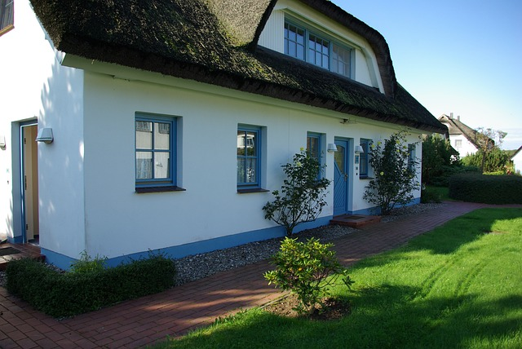
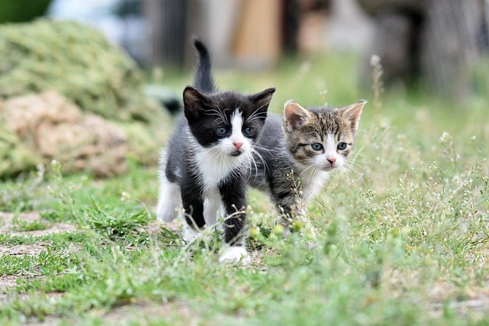
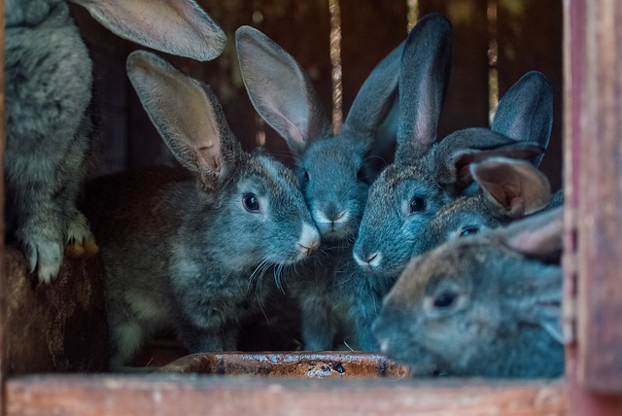
Let’s start... but first think…
Agrotourism
Agrotourism is a type of tourism where visitors travel to farms or rural areas to experience agricultural life and activities. This can include things like farm tours, picking fruits and vegetables, feeding animals, and learning about farming processes. Agrotourism offers tourists a chance to enjoy the countryside and learn about agriculture, while providing farmers with additional income.

Slide 4
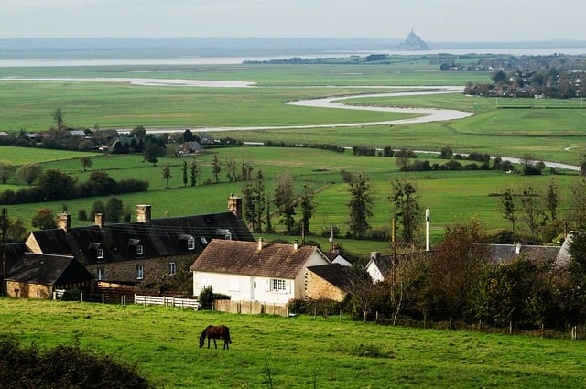
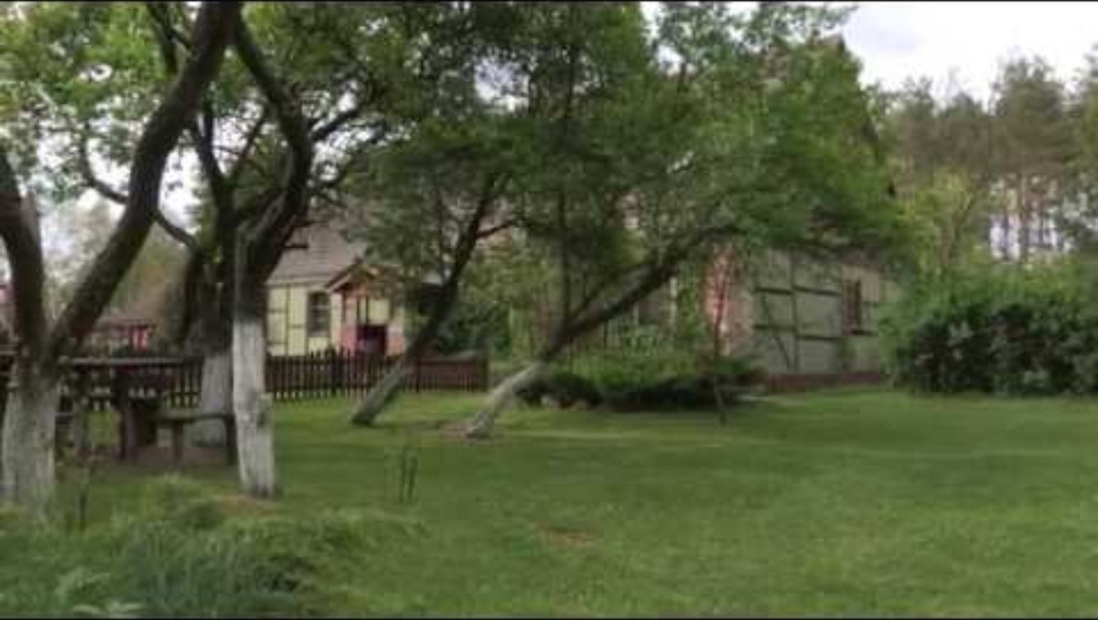
Rural tourism
What influences the attractiveness of rural areas for tourists? ☺
Rural tourism is all forms of recreation in rural areas, otherwise it is the entire rural tourism economy. Rural tourism is most popular in areas rich in nature with characteristic plant or animal species inhabiting a specific area at a specific time.
Thematic Villages, e.g. Herbs and Flowers Village, Berry Village, are an interesting tourist proposal.
The cultural heritage of a village is another idea for a tourist offer to participate in the life of the village and get to know its traditions, which are often linked to historical events in the region.

Slide 5
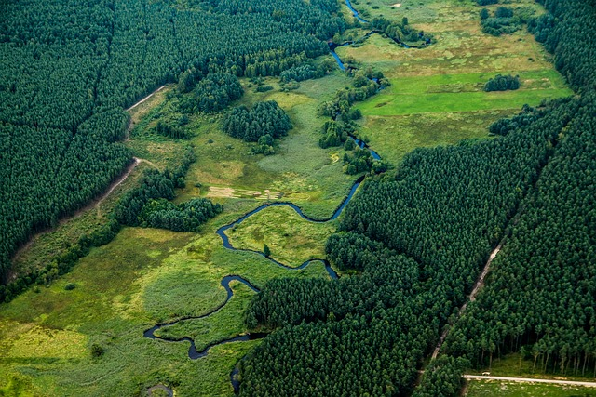
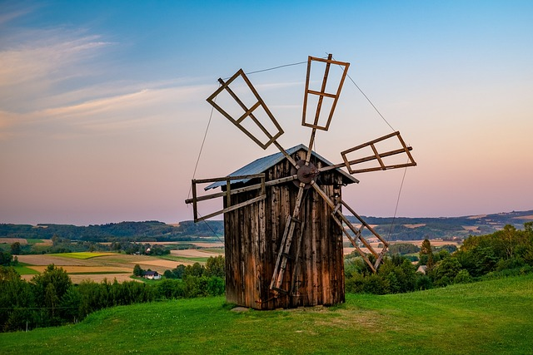
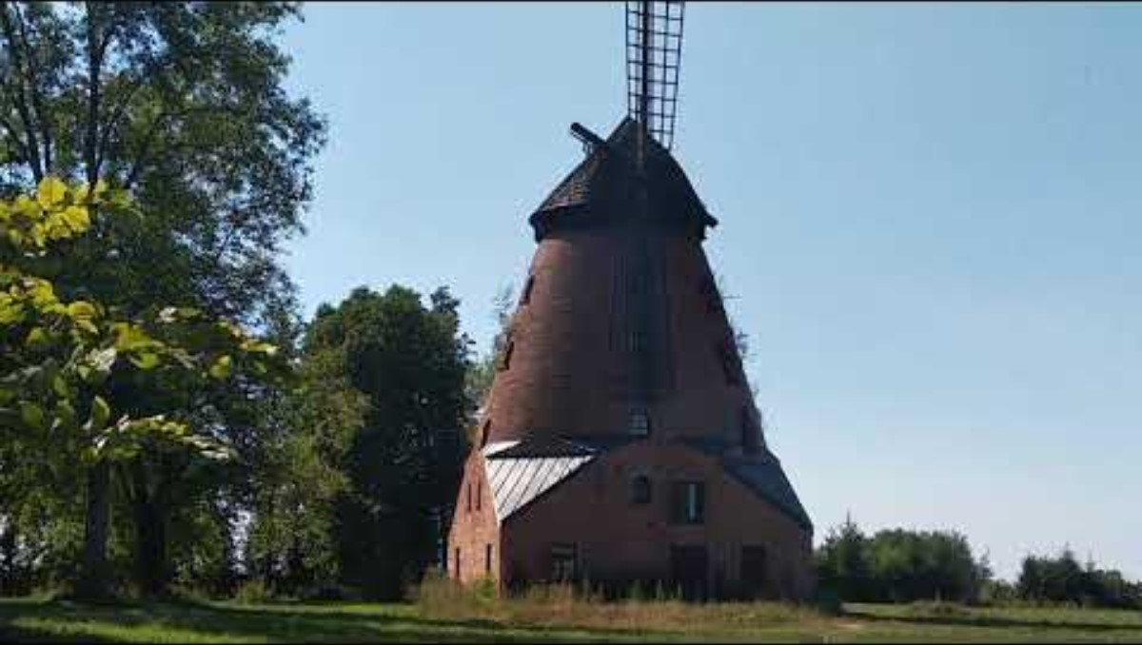
Challenges of rural tourism
Today, the rural tourist is looking for authentic experiences in the form of activities in nature, contact with nature and with animals. They are looking for unconventional accommodation solutions. It wants to rediscover ancient yet simple customs, rituals and culture of the region.
Challenges of today's rural tourism include:
To meet the expectations and needs of today's tourist,
To be appropriately prepared with the offer for tourists,
To be more familiar with the cultural heritage of villages, traditional professions, handicrafts and folk art,
To raise awareness on environmental aspects in rural areas.

Slide 6
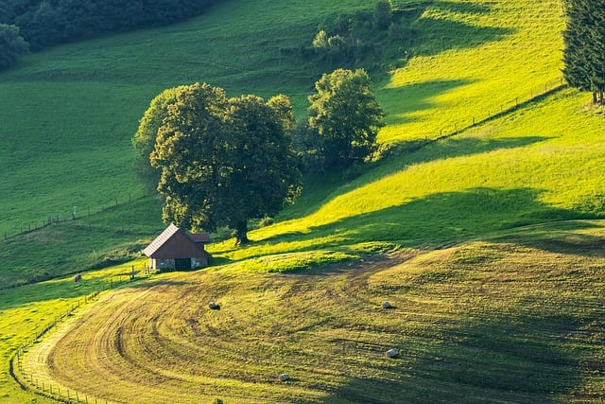
Opportunities for rural tourism development depend on a number of factors including:
the involvement of local people;
assistance from local government authorities;
educational and financial support from the state;
implementation of EU programmes;
making the tourist offer more attractive, e.g. the preparation of traditional dishes, as well as fruit and vegetable processing, presentation of traditional customs and rituals, handicraft workshops e.g. regional paper cut-outs and tissue paper decorations or baking bread figurines.
The benefits of rural tourism mainly include learning about the specifics of rural life, traditions, culture, a greater opportunity to get to know nature, and attractive leisure activities.
Rural tourism development
What are the benefits of rural tourism? ☺
Images downloaded from pixabay:
https://pixabay.com/pl/photos/g%C3%B3ry-%C5%9Bwi%C4%99tokrzyskie-klon%C3%B3w-5580604/
https://pixabay.com/pl/photos/polska-wie%C5%9B-krajobraz-natura-6102118/
https://pixabay.com/pl/photos/konie-%C5%9Bnieg-brzozowy-drzewa-natura-6184504/
https://pixabay.com/pl/photos/stary-wiatrak-wzg%C3%B3rzu-wiejski-5713337/
https://pixabay.com/pl/photos/rzeka-krajobraz-natura-zielony-2826927/
https://pixabay.com/pl/photos/kr%C3%B3liki-ma%C5%82e-kr%C3%B3liki-uszy-m%C5%82ode-4399624/
https://pixabay.com/pl/photos/koty-koci%C4%99ta-zwierz%C4%99-domowe-8105667/
https://pixabay.com/pl/photos/rugia-dom-wioska-rodzina-1869806/
https://pixabay.com/pl/photos/krajobraz-pole-%C5%82%C4%85ka-podw%C3%B3rko-dom-8592826/
https://pixabay.com/pl/photos/wioska-farmy-ko%C5%84-pola-8501168/
https://pixabay.com/pl/photos/krajobraz-most-rzymski-rzeka-8487906/

