Slide 1
Digital Skills Apps and Tools for rural Tourism

Slide 2
What to know before starting?
What will you learn?
How much time will it take?
30 minutes
Effectively use digital tools and applications to promote and manage rural businesses.
EQF level
Level 3
Leverage digital technologies to:
Attract more visitors,
Improve customer experience
Optimize the management of their operations in rural environments.
Who created the content and will recognise your learning?
This material was created by the partners of the Erasmus+ project “Upskilling Rural” that will recognise your learning as well.

Slide 3
Let’s start... but first watch this short video

Slide 4
The Relevance of Digital Tools in Rural Tourism:
Digital tools can offer practical solutions to overcome many of the common challenges faced by rural entrepreneurs:
Limited visibility: Rural businesses can struggle to stand out in a crowded market, but digital tools can help. Creating profiles on social media platforms like Facebook, Instagram, and Google My Business, can help businesses share information, photos, and reviews that attract potential customers. A solid online presence makes it easier for businesses to be found by people interested in rural areas.
Online Competition: With the rise of digital tourism, online competition has intensified. However, digital tools offer practical ways to stand out. Entrepreneurs can use digital marketing strategies, such as social media advertising and content marketing, to differentiate themselves and communicate their unique value proposition.

Slide 5
The Relevance of Digital Tools in Rural Tourism:
Reservation Management: Efficient reservation management is critical to the success of any tourism business. Digital tools, such as online reservation systems and customer management platforms, simplify this process.
These tools allow entrepreneurs to easily manage reservations, track availability and communicate with customers quickly and efficiently. In addition, automating certain aspects of the booking process, such as confirmations and reminders, reduces the possibility of errors and improves the customer experience.

Slide 6
Digital Tools and Useful Applications
Booking Platforms:
Benefits: It makes it easier for customers to book accommodations, activities, and services online, increasing convenience and accessibility.
Examples: Booking.com, Airbnb, Expedia.
Use in Rural Tourism: A rural hotel can use Booking.com to manage online bookings, reach a global audience, and increase occupancy during off-seasons.

Slide 7
Digital Tools and Useful Applications
Social Media Marketing Tools:
Benefits: allow businesses to promote their services, interact with customers and create an online community.
Examples: Facebook Business Manager, Instagram for Business, Twitter Ads.
Use in Rural Tourism: A tourist farm can use Instagram to share photos of its animals, landscapes and activities, attracting more visitors interested in authentic rural experiences.

Slide 8
Digital Tools and Useful Applications
Electronic Payment Solutions:
Benefits: facilitate secure and hassle-free transactions, increasing convenience for businesses and customers.
Examples: PayPal, Stripe, Square.
Use in Rural Tourism: A rural tour operator can use PayPal as a payment option on their website, allowing customers to book and pay for their activities quickly and securely from anywhere.

Slide 9
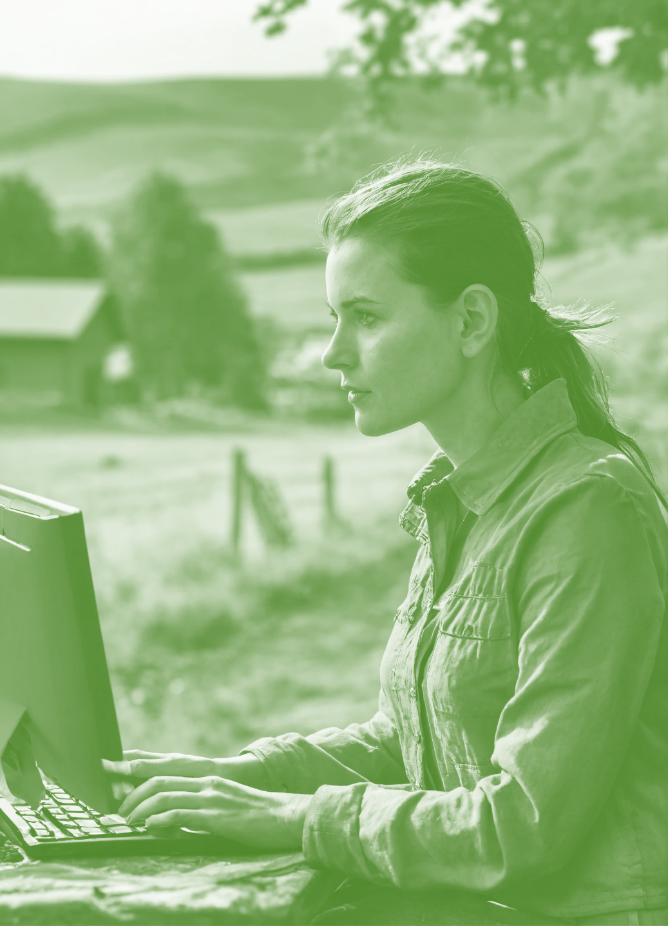
Digital Tools and Useful Applications
Customer Relationship Management (CRM):
Benefits: help organize and manage customer information, improve communication and deliver personalized experiences.
Examples: HubSpot CRM, Salesforce, Zoho CRM.
Use in Rural Tourism: An ecotourism company can use a CRM to track customer preferences and booking history, personalizing offers and communications to improve customer satisfaction and foster loyalty.

Slide 10
Practical Implementation of Digital Tools in Rural Tourism
Using digital tools to enhance the customer experience at all stages of their rural tourism journey is critical to ensuring customer satisfaction and fostering long-term loyalty. Here are some simple ways to do this:
Research and Booking:
Optimized Website: Make sure you have a user-friendly, mobile-optimized website where customers can easily find information about your business, services and location.
Online Booking Platform: Offer customers the option to book their experiences online through an integrated booking platform on your website or through third-party apps for added convenience.

Slide 11
Practical Implementation of Digital Tools in Rural Tourism
Stay:
Transparent and Timely Communication: Digital communication tools, such as email or text messaging, provide customers with important information before arrival, such as travel instructions, activity schedules, and accommodation details.
Personalization: This involves using customer management systems to collect information about customer's preferences and needs and deliver personalized experiences during their stay, such as recommendations for additional activities or services based on their interests.

Slide 12
Practical Implementation of Digital Tools in Rural Tourism
Subsequent Feedback:
Satisfaction Surveys: Send satisfaction surveys via email or online to collect customer feedback on their experience and areas for improvement.
Response and Follow-up: Respond quickly to customer comments and suggestions and follow up on actions to address any reported issues, demonstrating your commitment to customer satisfaction.

Slide 13
Sources
https://www.researchgate.net/publication/370609130_THE_IMPLEMENTATION_OF_GIS_TOOLS_FOR_PLANNING_THE_DEVELOPMENT_OF_RURAL_TOURISM_ALONG_THE_NETWORK_OF_OLD_SHEEP-TRACKS
https://www.hindawi.com/journals/wcmc/2022/9688023/
https://www.acelerapyme.gob.es/en/news/pill/rural-tourism-its-growth-thanks-digitalization
https://www.youtube.com/watch?v=QXWWpdRfGQI

