Slide 1
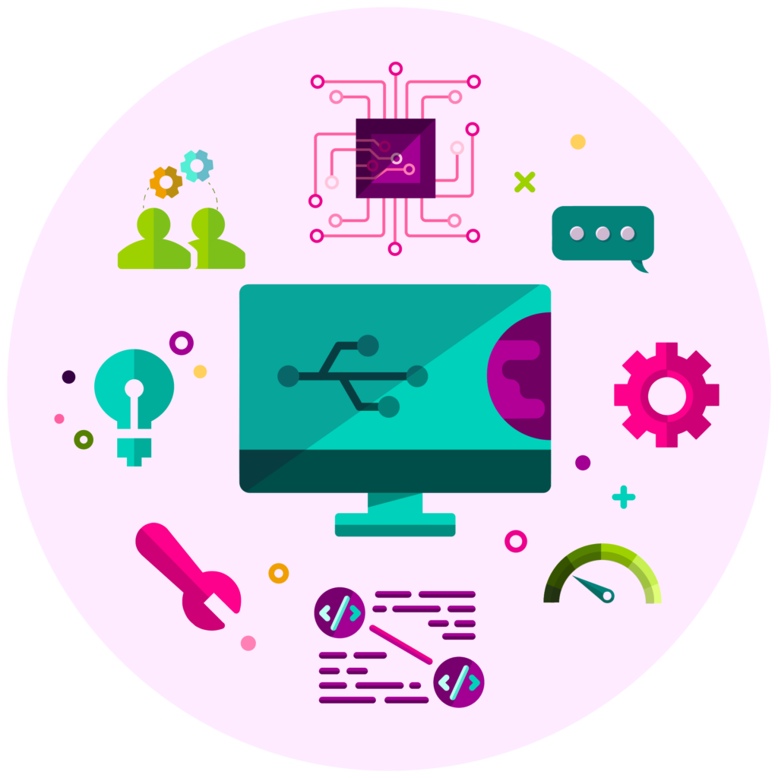
Digital Skills for Employment

Slide 2
What to know before starting?
What will you learn?
How much time will it take?
30 minutes
Understand the Importance of Digital Skills
EQF level
Develop Core Digital Competencies
Level 3
Utilize Digital Tools for Productivity
Enhance Digital Communication Skills
Who created the content and will recognise your learning?
Navigate Job Search and Career Development in the Digital Era
This material was created by the partners of the Erasmus+ project “Upskilling Rural” that will recognise your learning as well. MORE.

Slide 3
Let’s start... but first watch these short videos
Digital Literacy Skills to Succeed in Learning and Beyond | Yimin Yang | TEDxYouth@GrandviewHeights - YouTube
Join the Digital Skills and Jobs Platform - YouTube

Slide 4
Digital Skills
DEFINITION
Digital skills involve using digital devices, software, and online platforms for tasks like communication, collaboration, problem-solving, and accessing information.
In the European Union (EU), digital skills are vital for participating in the digital economy and society. The EU promotes these skills to boost competitiveness, innovation, and job opportunities. Programs like the Digital Skills and Jobs Coalition aim to bridge the digital skills gap through education and training. Employers value candidates with strong digital skills to navigate technological changes and lead digital transformation. Thus, individuals with good digital skills are more likely to secure jobs and foster economic growth in the EU.

Slide 5
Importance of digital skills in today's job market
In the EU, digital skills are crucial for participating in the digital economy and society. Initiatives like the Digital Skills and Jobs Coalition aim to bridge the digital skills gap through education and training. Employers highly value candidates with strong digital skills for navigating technological changes and leading digital transformation.
Digital Skills Initiatives in the EU
European Skills Agenda
Digital Education Action Plan
Digital Skills and Jobs Coalition

Slide 6
Core Digital Skills
Basic Digital Literacy: Understanding hardware, software, and operating systems.
Internet Skills: Browsing, searching, and evaluating online information.
Communication Skills: Email etiquette,
messaging apps, and online collaboration
tools.
Digital Security: Understanding cybersecurity
threats and safe online practices.

Slide 7
Digital Tools for Productivity
Office Suite Skills: Word processing, spreadsheets, and presentations.
Time Management Tools: Calendars, task managers, and productivity apps.
Cloud Computing: Online data storage and collaboration tools.

Slide 8
Digital Communication Skills
Professional Communication: Writing emails and maintaining professional online profiles.
Virtual Meeting Etiquette: Proper behavior in video conferences and webinars.
Remote Collaboration: Using digital tools for teamwork among remote teams.

Slide 9
Digital Skills for Job Search and Career Development
Online Job Search: Use job boards, career sites, and networks to find jobs and connect with professionals.
Personal Branding: Build a strong online presence with professional profiles, portfolios, and community engagement to show skills and achievements.
Continuous Learning: Keep learning with online courses and resources to improve skills and stay updated.
Mastering these skills helps people navigate the digital world, grow their networks, and advance their careers.

Slide 10
The Importance of the Digital Skills in Rural Areas
Remote Work Opportunities: These skills allow rural residents to access remote jobs, expanding their employment options without the need for long commutes.
Entrepreneurship: Digital skills empower rural entrepreneurs to establish online businesses, tapping into global markets and creating economic opportunities within their communities.
Online Education: With digital skills, rural individuals can access online education and training, improving their qualifications for various jobs without needing to relocate.
Telehealth Services: Digital literacy enables healthcare professionals in rural areas to provide remote consultations and services, improving access to healthcare for underserved populations.
Government and Nonprofit Services: Digital skills are essential for managing online services and programs, creating employment opportunities in public administration and social services within rural communities.

Slide 11
Digital Skills & EU
The EU aims to enhance digital skills, especially in rural areas, to achieve "connected rural
areas" by 2040. The Digital Education Action Plan 2021-2027 and the 2023 European Year
of Skills are key initiatives to improve digital skills and reach the targets of 80% of Europeans
with basic digital skills and 20 million ICT specialists by 2030.

Slide 12
Sources
Digital Skills for Employment | SpringerLink
What are Digital Skills for Work? | Importance & Examples (highspeedtraining.co.uk)
Digital skills and jobs | Shaping Europe’s digital future (europa.eu)
Digital skills | Shaping Europe’s digital future (europa.eu)
What Are Digital Skills & Why Are They Important? | UNLV
Strengthening digital skills of rural people to benefit from the digital era - European Union (europa.eu)

