Slide 1


Internationalization / foreign clientes (Product delivery)
Illustration 1:

Slide 2


What to know before starting?
What will you learn?
How much time will it take?
20 minutes
      Internationalization concept
EQF level
    Key Aspects of Internationalization
Level 3
Identify challenges and solutions
Who created the content and will recognise your learning?
Understand the benefits of Internationalization
This material was created by the partners of the Erasmus+ project “Upskilling Rural” that will recognise your learning as well.

Slide 3

Let’s start... but first think

Slide 4
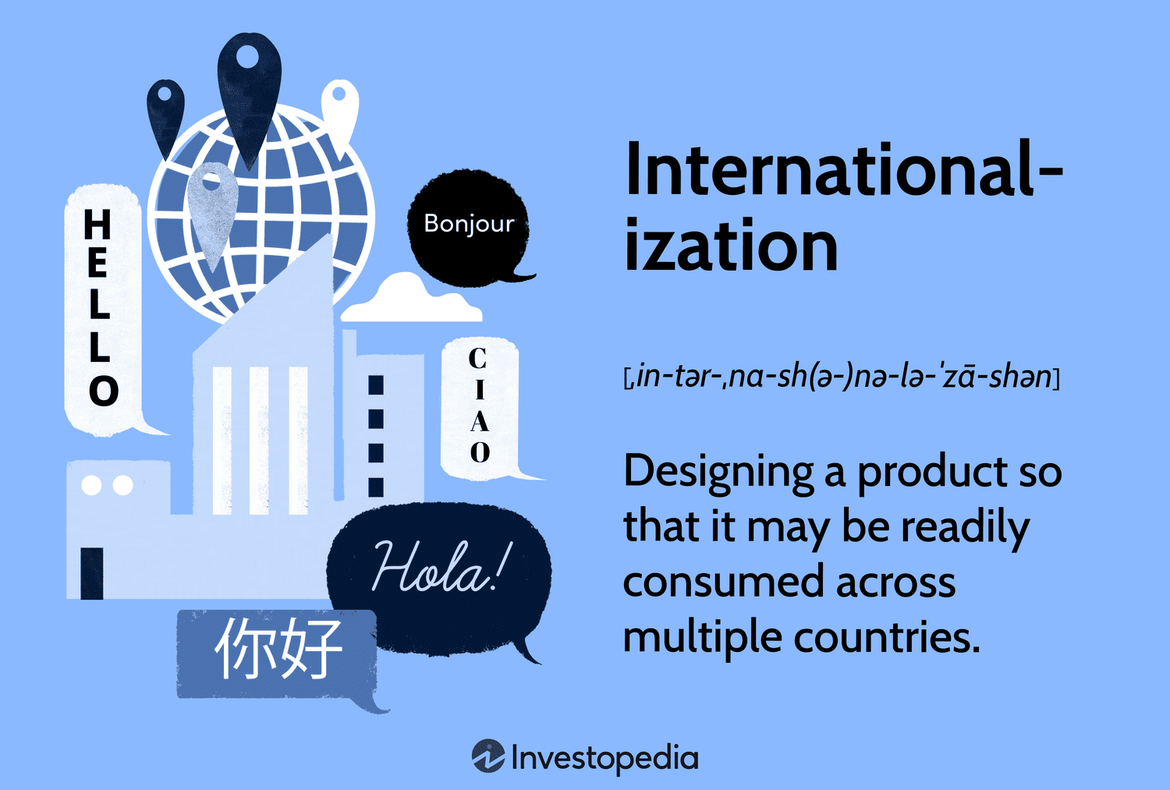
Internationalization
Internationalization (often abbreviated as i18n) refers to the process of designing products, services, and content in a way that they can be easily adapted for various languages, regions, and cultures. This process is crucial for businesses looking to expand their reach to foreign clients and deliver products internationally. Here's an overview of the key aspects:
Illustration 2:

Slide 5
Key Aspects of Internationalization
Localization (L10n)
  Localization involves adapting a product for a specific market. This includes translating text, adjusting formats for dates, times, and numbers, and modifying cultural references.
  Example: A US-based website might use a MM/DD/YYYY date format, whereas a European version would use DD/MM/YYYY.
Technical Adaptations
  Unicode Support: Ensure your software can handle various character sets. Unicode is a standard for encoding text in different languages.
  Right-to-Left (RTL) Support: Some languages, like Arabic and Hebrew, are read from right to left. Your product should be able to adapt to these languages.

Slide 6
Key Aspects of Internationalization
3. Legal and Regulatory Compliance
  Products must comply with local laws and regulations, which can vary widely. This includes data privacy laws (like GDPR in Europe), consumer protection laws, and product standards.
  Example: Electronic devices might need different certifications and voltage requirements.
4. Currency and Payment Methods
  Support multiple currencies and local payment methods. This can significantly increase the likelihood of completing sales.
  Example: In some countries, people prefer to use payment methods like Alipay or WeChat Pay.

Slide 7
Key Aspects of Internationalization
Cultural Sensitivity
  Be aware of cultural differences and ensure your content is appropriate for different regions. This includes avoiding cultural taboos and understanding local customs and preferences. Analise your target countries and try to use easy language, avoiding references to „sensitive topics“ (ex. Religion, politics, …)
Logistics and Distribution
  Efficiently managing the logistics of shipping products internationally is crucial. This includes understanding customs regulations, handling duties and taxes, and ensuring reliable delivery.
  Partnering with local logistics companies can help streamline this process.

Slide 8

Key Aspects of Internationalization
Customer Support
  Offering customer support in multiple languages can enhance user satisfaction. This includes providing FAQs, help documentation, and live support in the customer's native language.
Marketing and Advertising
  Tailoring marketing strategies to fit local tastes and trends. This might involve using different advertising platforms and understanding local social media usage.
Illustration 3:

Slide 9

Challenges and Solutions
Challenge: Translation Quality
Solution: Use professional translation services and employ native speakers to ensure the content is culturally relevant and accurate. Make sure the content is easy to understand and is culturally neutral to avoid cultural misunderstandings.
Challenge: Time Zone Differences
Solution: Take into consideration time-zone differences in terms of customer service. For small rural businesses you can use tools like Whatsapp Business that allow you to set up automatic messages/answers, allowing you to manage them in your working hours.
Illustration 4:

Slide 10
Challenges and Solutions
Challenge: Managing International/Distance working Teams
Solution: Use collaboration tools and establish clear communication protocols to manage teams working at distance
Challenge: Different Legal Environments
Solution: Consult with legal experts in each target country to ensure compliance with local laws and regulations – analyse regulations depending if you want to export within the EU and/or outside.
Illustration 4:

Slide 11
Benefits of Internationalization
  Market Expansion: Access to new markets and a larger customer base can increase sales and profits.
  Diversification: this is a key aspect for small rural businesses. Approaching international markets can reduce the reliance on local conditions and fortify the income of the businesses, making them more resilient.
  Brand Recognition: Establishing a regional/global presence can enhance brand reputation and recognition.
  Competitive Advantage: entering in an international market can inspire businesses to improve efficiency, quality and innovation

Slide 12
Sources
Source 1: https://www.bmbf.de/bmbf/de/europa-und-die-welt/vernetzung-weltweit/vernetzung-weltweit_node.html
Source 2: https://www.investopedia.com/terms/i/internationalization.asp
Source 3: https://www.linkedin.com/pulse/reasons-internationalisation-nishida-mohan
Source 4: https://eraofkashmir.com/2023/04/07/challenges-and-solutions/

