Slide 1
Building Long Lasting Networks, including Business Canvas
Illustration 1:

Slide 2
What to know before starting?
What will you learn?
How much time will it take?
20 minutes
Understanding what networking is
EQF level
Understanding of Business canvas concept and Elements
Level 3
Practical Tips for Sustaining Networks
Who created the content and will recognise your learning?
This material was created by the partners of the Erasmus+ project “Upskilling Rural” that will recognise your learning as well.

Slide 3
Let’s start... but first think

Slide 4
What is Networking?
It is the act of building relationship with other people and companies in your business field. It includes exchanging information, ideas and contacts for mutual benefit.
Networking can be done online and offline.
Online – through platforms like LinkedIn or other similar platforms
Offline – through participation in events, conferences, community meetings, etc.

Slide 5
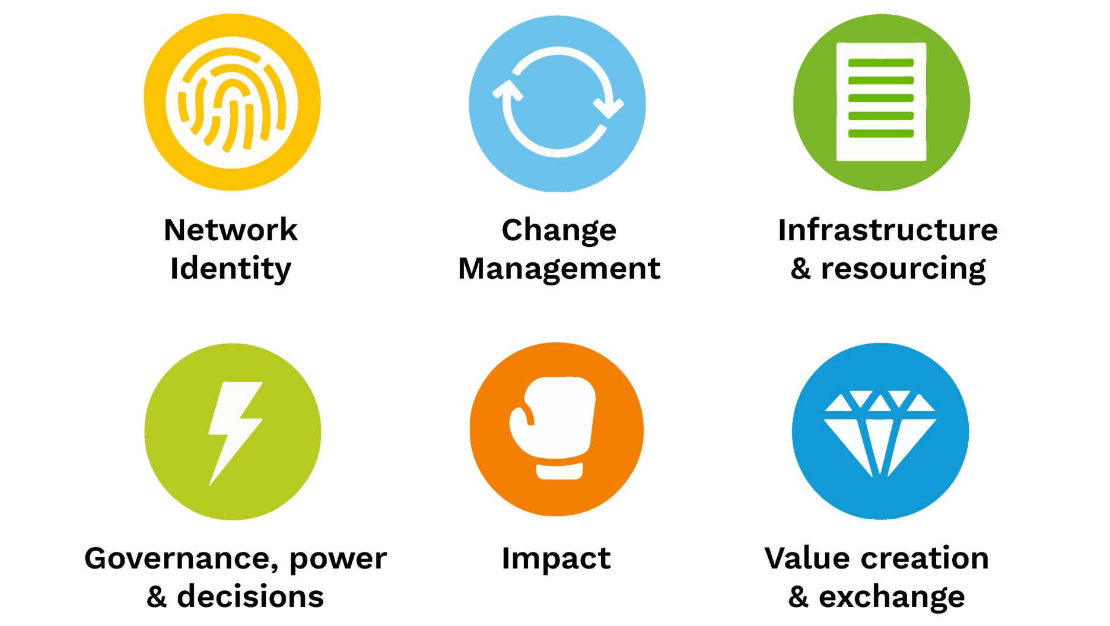
Building Long Lasting Networks, including Business Canvas
Building long-lasting networks, especially in a business context, involves strategic planning, relationship management, and leveraging various frameworks like the Business Model Canvas. Here's a comprehensive guide to help you build and sustain effective networks:
Illustration 2:

Slide 6
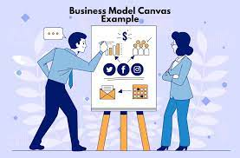
Understanding the Business Model Canvas
The Business Model Canvas is a strategic management tool that allows you to visualize and describe the key elements of your business model. It consists of 9 elements.
A Business Canvas is a model that must be regularly updated to respond better to the changes in the market.
Illustration 3:

Slide 7
Understanding the Business Model Canvas
Customer Segments: Define your different groups of customers.
Value Propositions: Describe the unique value your business offers to each customer segment.
Channels: Identify how you will deliver your value propositions to your customers.
Customer Relationships: Outline the type of relationship you want to establish with each customer segment.
Revenue Streams: Explain how your business will earn money from each customer segment.
Key Resources: List the most important assets required to make your business model work.
Key Activities: Describe the most important actions you must take to operate successfully.
Key Partnerships: Identify the network of suppliers and partners that make your business model work.
Cost Structure: Outline the major costs involved in operating your business model.

Slide 8
Building Long-Lasting Networks
Identify and Understand Your Network:
Internal Networks: Employees, departments, and internal stakeholders.
External Networks: Customers, suppliers, partners, industry associations, and competitors.
Leverage the Business Model Canvas:
Customer Relationships: Use the canvas to define how to build and maintain relationships. Consider loyalty programs, personalized communication, and community engagement.
Key Partnerships: Identify strategic partners. These could be suppliers, joint ventures, alliances, or industry groups.
Strong Customer Relationships:
Personalization: Tailor interactions based on customer preferences and history.
Engagement: Regularly engage with customers through newsletters, social media, and events.
Feedback Loop: Establish channels for receiving and acting on customer feedback.

Slide 9
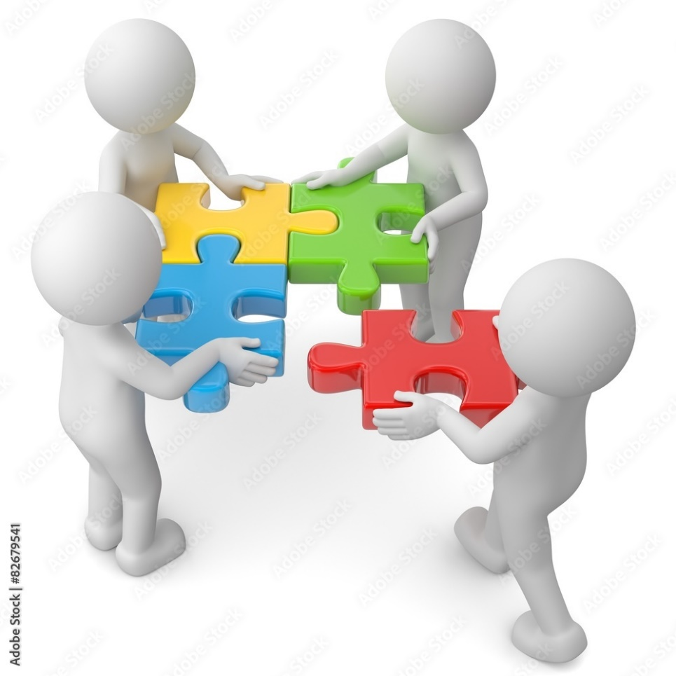
Building Long-Lasting Networks
Build Trust and Credibility:
Consistency: Deliver on promises and be consistent in your offerings and communications.
Transparency: Be open about your business practices, values, and any changes that may affect stakeholders.
Reliability: Ensure that your products or services meet the expectations consistently.
Networking and Relationship Building:
Industry Events: Attend conferences, trade shows, and seminars to meet potential partners and customers.
Online Presence: Use social media and professional platforms like LinkedIn to connect with industry peers and potential partners.
Content Sharing: Share valuable content that demonstrates your expertise and thought leadership.
Illustration 4:

Slide 10
Building Long-Lasting Networks
Mutual Value Creation:
Collaborative Projects: Work on joint ventures or projects that provide mutual benefits.
Resource Sharing: Share knowledge, resources, and insights with your network to foster a collaborative environment.
Referral Systems: Establish a referral system where network members can refer clients to each other.
Regular Maintenance and Follow-up:
Check-ins: Regularly check in with your network to maintain relationships.
Updates: Keep your network updated on your business developments and seek updates from them.
Support: Offer support and assistance to your network when needed, and ask for help when you need it.

Slide 11
Building Long-Lasting Networks
Identify and Understand Your Network:
Internal Networks: Employees, departments, and internal stakeholders.
External Networks: Customers, suppliers, partners, industry associations, and competitors.
Leverage the Business Model Canvas:
Customer Relationships: Use the canvas to define how to build and maintain relationships. Consider loyalty programs, personalized communication, and community engagement.
Key Partnerships: Identify strategic partners. These could be suppliers, joint ventures, alliances, or industry groups.
Strong Customer Relationships:
Personalization: Tailor interactions based on customer preferences and history.
Engagement: Regularly engage with customers through newsletters, social media, and events.
Feedback Loop: Establish channels for receiving and acting on customer feedback.

Slide 12
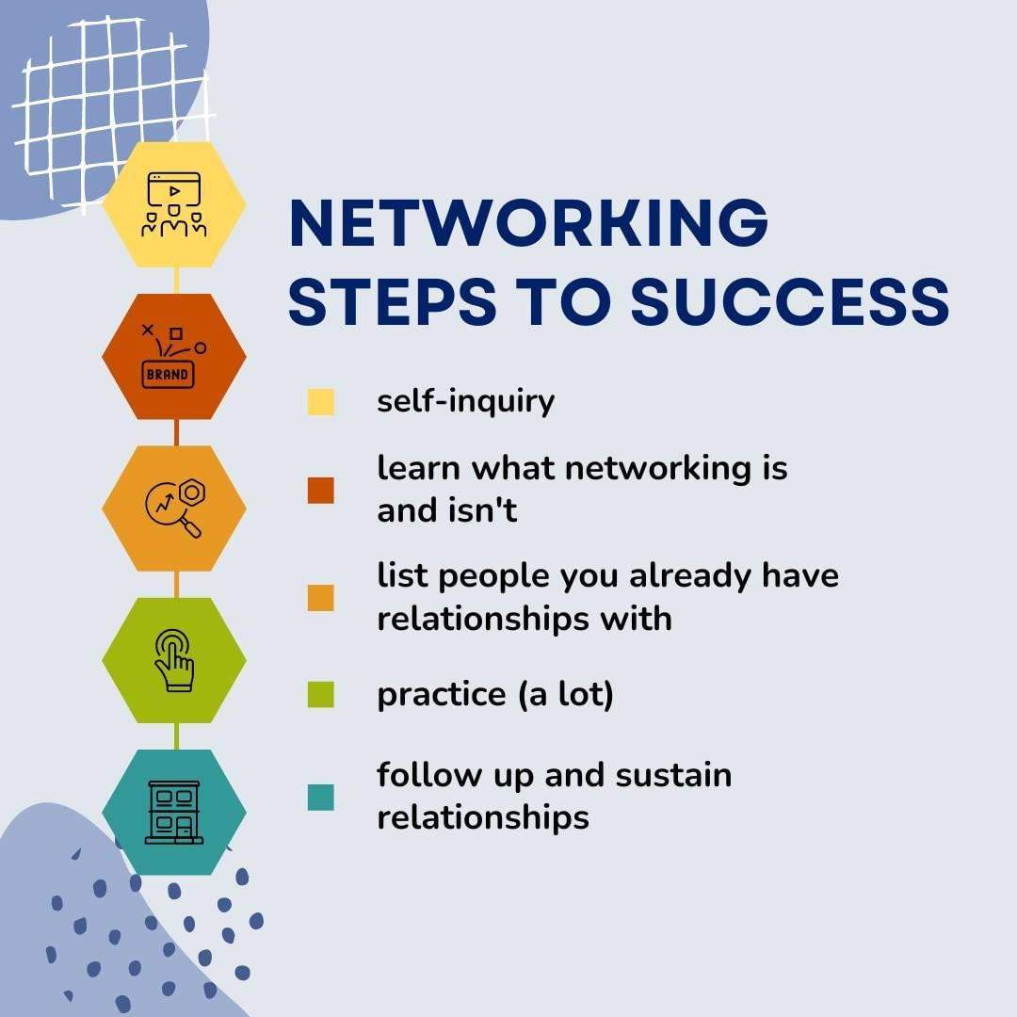
Practical Tips for Sustaining Networks
CRM Systems: Implement Customer Relationship Management (CRM) systems to manage and analyze customer interactions and data.
Networking Tools: Use tools like LinkedIn, professional networking groups, and industry-specific forums.
Continuous Learning: Stay updated with industry trends, and continuously seek to learn and grow your network.
Follow-up: After initial meetings, follow up with personalized messages or emails to keep the connection alive.
Illustration 5:

Slide 13
Source
Source 1: https://www.hypergene.com/resources/blog/business-model-what-it-is-and-how-you-create-one/
Source 2: https://www.ecommerce-nation.com/business-model-canvas-examples-step-guide/
Source 3: https://thesocialchangeagency.org/resources/network-building-canvas-peer-network/
Source 4: https://stock.adobe.com/de/images/teamwork-zusammenarbeit/82679541
Source 5: https://www.instagram.com/p/CtM1wVGJduU/?ref=syn_article_esquireph&hl=cs

