Slide 1
Community engagement and involvement
Insert your image here
Illustration 1:

Slide 2
What to know before starting?
What will you learn?
How much time will it take?
30 minutes
Introduction to the topic
EQF level
Understanding Community Engagement
Level 3
Strategies for Effective Community Engagement
Who created the content and will recognise your learning?
Challenges and Benefits
This material was created by the partners of the Erasmus+ project “Upskilling Rural” that will recognise your learning as well.

Slide 3
Let’s start... but first a Video

Slide 4
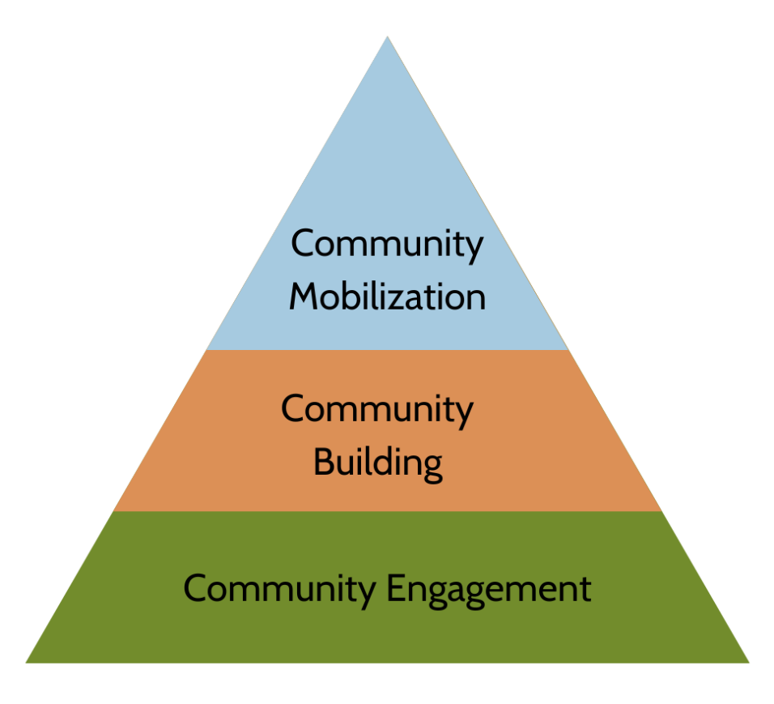
Community engagement and involvement
Community engagement and involvement are crucial components in fostering a vibrant and
resilient society. They encompass a range of activities and approaches designed to connect
individuals, groups, and organizations within a community, encouraging active participation,
collaboration, and a sense of ownership over communal issues and initiatives. Here are key
aspects and strategies of community engagement and involvement.
GOALS
Empowerment: Enable community members to take control over their lives and
environment.
Inclusion: Ensure that all voices, especially those traditionally marginalized, are
heard.
Sustainability: Develop long-term solutions that the community can maintain.
Capacity Building: Enhance the skills, knowledge, and resources within the
community.

Slide 5
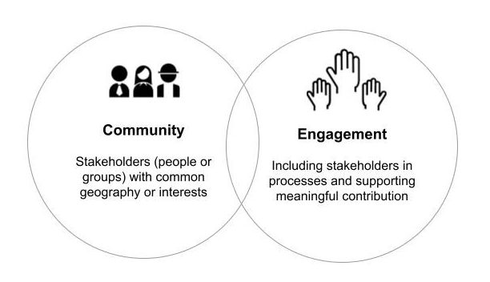
1. Understanding Community Engagement
Definition:
Community engagement refers to the process of working collaboratively with and
through groups of people affiliated by geographic proximity, special interest, or similar
situations to address issues affecting their well-being. It involves partnerships, coalitions, and
public participation to achieve desired outcomes.
Illustration 2:

Slide 6
2. Strategies for Effective Community Engagement
1. Building Trust and Relationships:
Listening Sessions: Hold informal gatherings where community members can voice concerns and ideas.
Transparency: Share information openly and honestly.
Consistency: Regular interactions and follow-ups to build reliability.
2. Inclusive Participation:
Diverse Outreach: Use multiple channels (social media, local
events, flyers) to reach
different demographics.
Illustration 3:
Accessible Meetings: Hold meetings at convenient times and locations; provide
translation services if needed.

Slide 7
3. Collaborative Planning:
Workshops and Forums: Facilitate sessions where community members can
contribute to planning and decision-making processes.
Advisory Committees: Form committees that include community representatives to
advise on projects and policies.
4. Education and Capacity Building:
Training Programs: Offer workshops on leadership, project management, and other
relevant skills.
Resource Sharing: Provide access to tools, funding opportunities, and networks.
5. Leveraging Technology:
Online Platforms: Use social media, community apps, and websites to disseminate
information and gather feedback.
Virtual Town Halls: Conduct meetings online to increase accessibility.

Slide 8
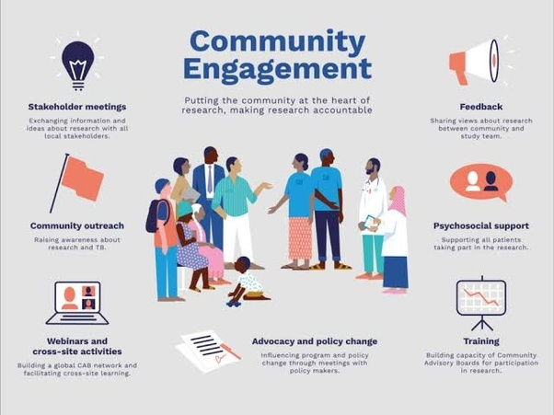
3. Examples of Community Engagement Initiatives
1. Neighborhood Associations: Groups that organize events, advocate for local issues, and foster a sense of community.
2. Participatory Budgeting: A democratic process where community members decide how to allocate part of a public budget.
3. Community Gardens: Shared spaces where residents can grow food, learn gardening skills, and build community connections.
4. Youth Councils: Platforms for young people to engage in local governance and community projects.
5. Health Initiatives: Programs that involve community members in health education, prevention, and intervention activities.
Illustration 4:

Slide 9
4. Benefits of Community Engagement
1. Enhanced Trust: Building trust between community members and institutions leads to more effective and accepted interventions.
2. Increased Social Cohesion: Active participation fosters a sense of belonging and mutual support among community members.
3. Better Outcomes: Policies and projects that incorporate community input are more likely to address actual needs and be sustainable.
4. Empowered Communities: Engaged communities develop the capacity to advocate for themselves and drive their own development.
5. Innovation and Creativity: Diverse perspectives lead to innovative solutions to
community challenges.

Slide 10
5. Challenges and Considerations
1. Overcoming Barriers: Addressing issues such as language differences, transportation, and socio-economic disparities.
2. Managing Conflicts: Facilitating dialogue and negotiation when interests and opinions clash.
3. Ensuring Continuity: Keeping engagement efforts sustained over time despite changes in leadership or funding.
4. Measuring Impact: Developing metrics to assess the effectiveness of community engagement initiatives.
Illustration 5:

Slide 11
Source
Source 1: https://www.hypergene.com/resources/blog/business-model-what-it-is-and-how-you-create-one/
Source 2: https://simplystakeholders.com/what-is-community-engagement/
Source 3: https://www.socialpinpoint.com/10-tips-to-encourage-community-engagement-in-diverse-communities/
Source 4: https://www.google.de/url?sa=i&url=https%3A%2F%2Fwww.quora.com%2FWhat-is-the-importance-and-purpose-of-community-engagement&psig=AOvVaw0XaPBGzm5kxuFnivHZau2V&ust=1719041078917000&source=images&cd=vfe&opi=89978449&ved=0CAMQjB1qFwoTCKDV2piV7IYDFQAAAAAdAAAAABAJ
Source 5: https://practicebusiness.co.uk/making-difficult-decisions-considerations-and-challenges-to-consider

