Slide 1
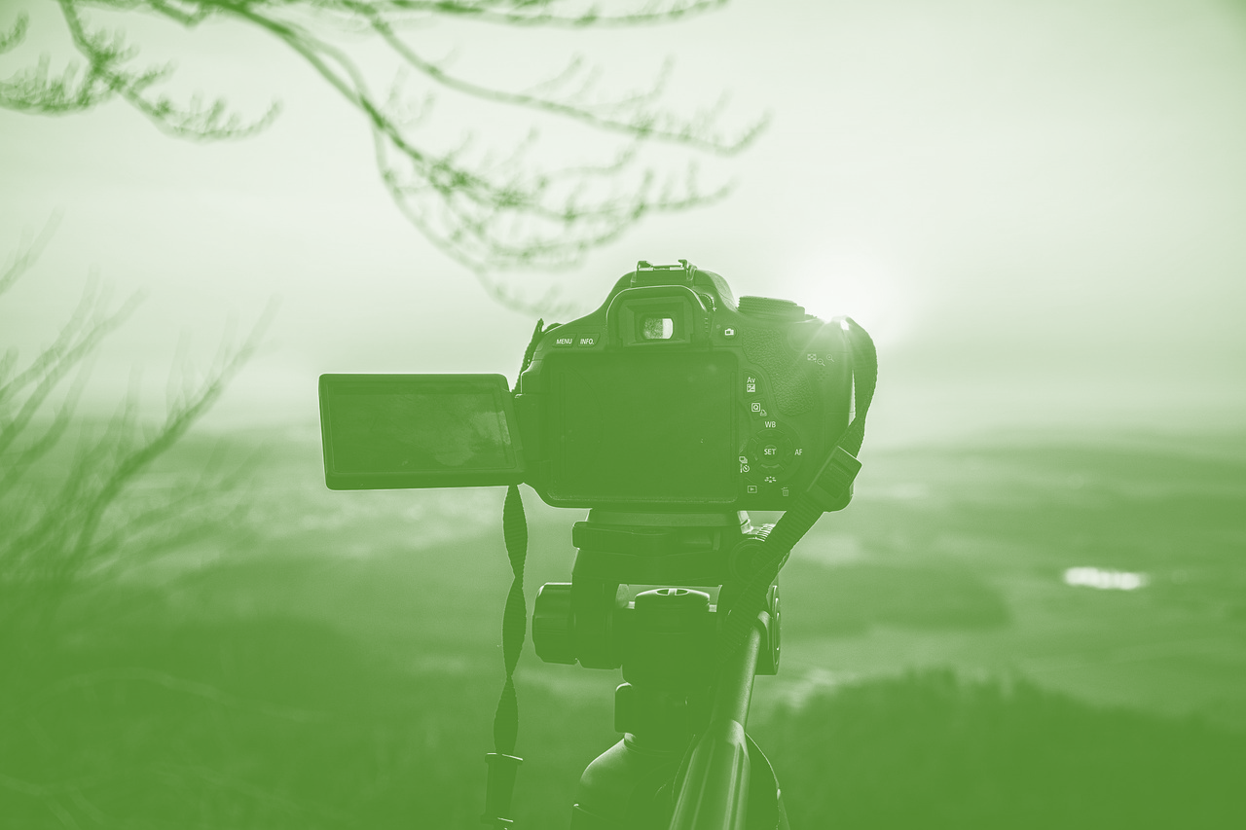
Introduction to E-Marketing through Pictures and Video

Slide 2
What to know before starting?
What will you learn?
How much time will it take?
30 minutes
Define the basics of e-marketing applied to rural entrepreneurship.
EQF level
Level 3
Acquire practical concepts that can be immediately applied to visual content development.
Who created the content and will recognise your learning?
Know the most recommended social networks for producing visual content and how to get the most out of each
This material was created by the partners of the Erasmus+ project “Upskilling Rural” that will recognise your learning as well.

Slide 3
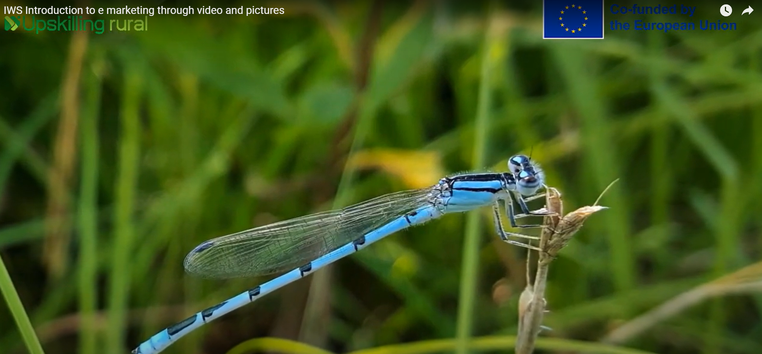
Let’s start... but first watch this short video

Slide 4
Fundamentals of e-Marketing in Rural Tourism
E-marketing in rural environments is the strategic use of digital tools and platforms to promote destinations and services. It uses the Internet, social networks, email, and other digital media to reach and attract potential visitors.
How can a rural entrepreneur benefit from the global reach offered by e-marketing?
Through online presence and social media, you can reach a diverse audience worldwide, regardless of geographic location, facilitating the visibility and promotion of rural destinations.
E-marketing enables direct and personalized interaction with potential customers; this direct communication helps build strong customer relationships and meet their specific needs.
Destinations can showcase the natural beauty and unique culture through engaging visual content and attract travellers searching for genuine and enriching experiences.

Slide 5
Creation of Visual Content for Rural Tourism
Captivating visual content is essential for rural tourism marketing. Use your local resources and creativity to showcase your business or destination through images and videos that inspire visitors to explore and enjoy all that you have to offer.
Tips for creating visual content:
Identify your unique selling points: Before creating visual content, identify what makes your business or rural destination unique. A stunning scenery, unique activities, or an exciting story? Your visual content should be based on your unique aspects to stand out in the marketplace.
Plan your content: Plan what you want to show and how. Create a content plan that includes the topics to cover, the places to highlight, and the visual style. This will help you maintain consistency and tell a compelling story about your business or destination.

Slide 6
Creation of Visual Content for Rural Tourism
Use basic but effective equipment: A digital camera or a smartphone can be enough to capture impressive images. For professional results, make sure your photos and videos are well-lit, focused, and free of distractions.
Highlight authenticity and the local experience: Highlight the natural beauty, local culture and unique activities your destination offers.
Tell a visual story: Try to create visual content that tells a story about your business or destination. Show visitors what life is like in the countryside, the activities they can do, and the people they will meet during their visit.
Be authentic and transparent: Authenticity is critical in rural tourism. Make sure your visual content is honest and accurately reflects what visitors can expect to find. Avoid overly edited images or videos that may give a false impression of your business or destination.

Slide 7
Integration of visual content into marketing and social media platforms
As a rural entrepreneur interested in promoting your business or destination, selecting the proper marketing and social media platforms to publish your visual content is crucial.
Here are the most popular alternatives:
Instagram is the visual platform par excellence, ideal for sharing high-quality images and videos. It is especially effective for showcasing the natural beauty, local culture, and authentic experiences your rural destination has to offer.
Facebook remains a relevant platform for rural tourism marketing because of its large user base and ability to share various content, including images, videos, and text.

Slide 8
Integration of visual content into marketing and social media platforms
YouTube is the leading online video-sharing platform, an excellent option for posting longer, more detailed videos about your business or rural destination. You can show virtual tours, interviews with locals, or local activities, giving viewers an immersive and authentic experience.
Pinterest is a highly visual platform for discovering ideas and inspiration. It benefits rural tourism businesses that want to highlight outdoor activities, local recipes, rustic decor, and more. You can create themed boards that reflect the identity and charm of your rural destination and share content that appeals to your target audience.
TikTok: You can use it to share videos that showcase country life and outdoor activities. It's a great way to reach a younger audience and generate interest in your destination.

Slide 9
Integration of visual content into marketing and social media platforms
To effectively promote your business or rural destination on social media and marketing platforms, consider your content, target audience, and objectives. Maintain an active presence, interact with followers, and measure content performance to adjust your strategy as needed.

Slide 10
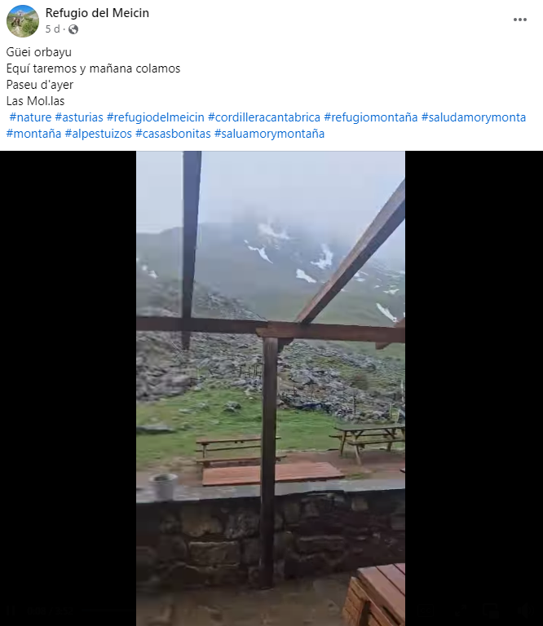
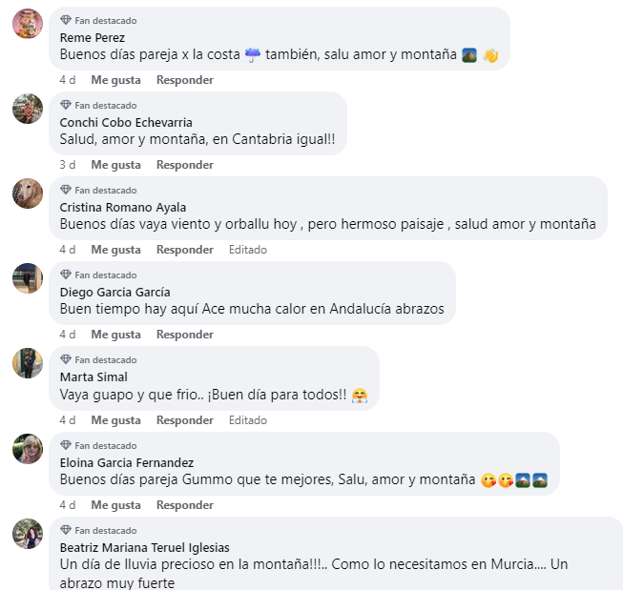
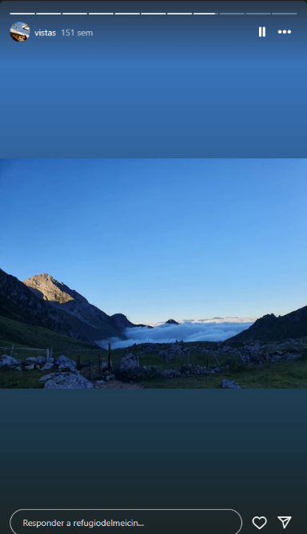
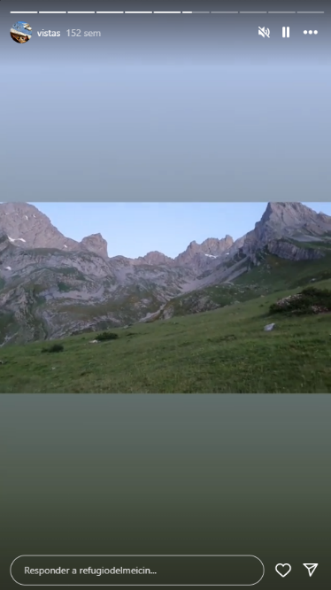
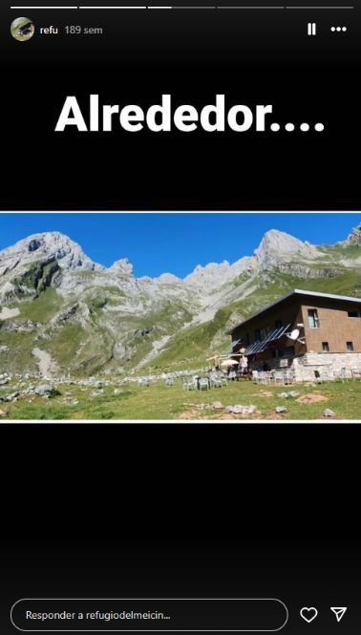
Example from the Real World:
Refugio de Meicin:
This mountain hostel, nestled in an isolated and unpopulated environment, idyllic for nature lovers but away from the tourist circuits, can reach its audience by its means using pictures and video through two main channels:.
Facebook: Indicated to incorporate broader messages and interact with followers.
Instagram: The best channel to show the plastic beauty of the shelter's environment and facilities.

Slide 11
Sources
https://www.hosteltur.com/comunidad/nota/004928_la-importancia-del-video-en-el-marketing-turistico.html
https://www.iebschool.com/blog/que-es-marketing-turistico-estrategias-marketing-digital/
https://www.hosteltur.com/comunidad/004659_5-razones-para-usar-el-video-en-el-sector-turistico.html
https://www.facebook.com/refugiomeicin
https://www.instagram.com/refugiodelmeicin/
https://www.youtube.com/watch?v=8JiGRLWijQY

