Slide 1
E-marketing – AI and metaverse spaces

Slide 2
What to know before starting?
What will you learn?
How much time will it take?
30 minutes
Understand the basic concepts of artificial intelligence and the metaverse.
EQF level
Level 3
Explore how these technologies can benefit rural tourism.
Who created the content and will recognise your learning?
Learn tools and techniques to create engaging virtual environments for rural tourism
This material was created by the partners of the Erasmus+ project “Upskilling Rural” that will recognise your learning as well.

Slide 3
Let’s start... but first watch this short video

Slide 4
Fundamentals of Artificial Intelligence and the Metaverse in Rural Tourism
Introduction: Artificial Intelligence (AI) enables machines to perform tasks that typically require human intelligence, including machine learning, natural language processing, and computer vision.
In rural tourism, AI can revolutionize the traveller's experience by:
personalizing recommendations according to their preferences,
optimizing tourist routes,
and improving resource management such as accommodation and activity availability.
The implementation of AI technology in rural tourism is a game-changer that should be noticed.

Slide 5
Fundamentals of Artificial Intelligence and the Metaverse in Rural Tourism
Introduction: The term "metaverse" refers to a computer-generated 3D virtual space where people can interact with one another and digital objects in an immersive manner. In rural tourism, the metaverse can be employed to create virtual experiences that allow visitors to:
explore remote locations,
take part in cultural activities,
and learn about the history and nature of the region, all without having to be physically present at the destination.
This can enhance the visibility and accessibility of rural destinations, drawing a broader and more diverse audience.

Slide 6
Artificial intelligence as a tool to improve experiences in rural environments
AI in rural environments facilitates the collection of knowledge and comments from travellers in territories that usually lack assessment and interaction platforms. Intelligence systems can collect tourist responses, reactions and impressions, increasing the chances of raising awareness of a tourist destination. In addition, AI has been used to restore tourist flows, recommend lesser-known areas to tourists, and contribute to the equitable distribution of the economy.
Innovative digital platforms and applications, such as MyStreetBook, use virtual reality and intelligent routes to personalize user experience.
Example from the Real World
https://mystreetbook.es/

Slide 7
Design and Development of Immersive Experiences in the Metaverse.
Immersive experiences can significantly improve promotion and visitor engagement in rural areas.
By providing a unique and captivating way to explore and experience destinations, visitors can immerse themselves in virtual environments that realistically recreate places of interest, cultural activities and natural landscapes, even before they arrive.
This not only generates greater interest in visiting the location in person but also increases tourist engagement once they arrive, ultimately making the whole experience more memorable and enjoyable.

Slide 8
Design and Development of Immersive Experiences in the Metaverse.
Immersive experiences can enhance promotion and visitor engagement in areas through:
Realistic Visualization: Immersive experiences can provide a realistic visual representation of rural destinations, allowing visitors to virtually explore places of interest, such as natural parks, picturesque villages and historical sites.
Interactivity: Virtual environments can offer interactive interactions that allow visitors to actively participate in the experience, such as walking along virtual trails, interacting with historical characters in digital recreations, and participating in virtual cultural and sports activities.
Personalization: Immersive experiences can be customized to suit visitors' interests, offering navigation and activity options matching their preferences and travel objectives.

Slide 9
Design and Development of Immersive Experiences in the Metaverse.
To create attractive virtual environments for rural tourism, different tools and techniques can be used, including:
Virtual Reality (VR): VR technology allows visitors to fully immerse themselves in digital environments through the use of VR viewers. 360° cameras can capture high-quality images of rural landmarks and then combine them with visual and sound effects to create immersive experiences.
3D Virtual Tours: 3D virtual tours of rural destinations can be created using modelling and rendering software. These tours can include highlights, information on local history and culture, and interactive activities for visitors.
Augmented Reality (AR) apps can overlay digital information on top of the physical world, allowing visitors to see additional details about rural attractions through their mobile or tablet devices. This can include historical information, geographic data, and audio commentary.

Slide 10
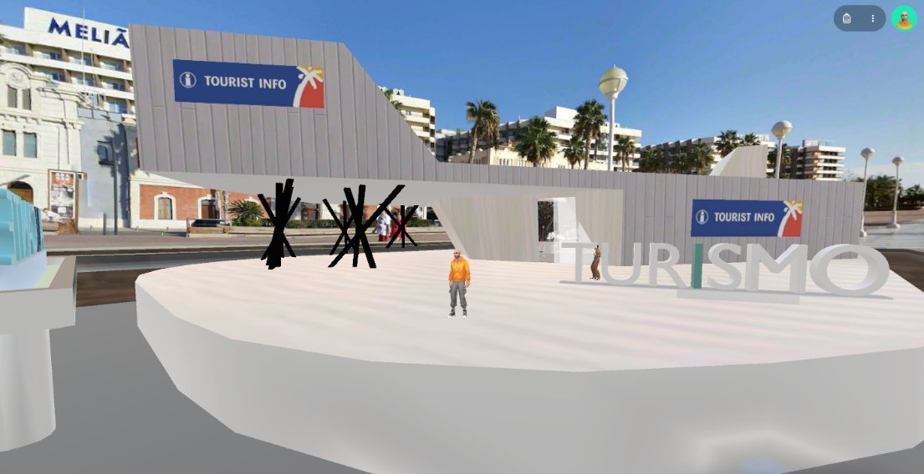
Design and Development of Immersive Experiences in the Metaverse.
Example from the Real World:
Intelligent Tourist Office adaptable to metaverses:
"Gamifiable" design
Multimedia interior environment: information about the city, tourist offers and events.
Multi-access (glasses, web, app...). Access to the virtual reality office)
Open space to promote activities (concerts, meetings, conferences...).
Intelligent virtual assistants that attend to the public in the metaverse office 24 hours a day, 365 days a year.
Access from the office to the most emblematic virtual spaces in the city.

Slide 11
Sources
https://digital-strategy.ec.europa.eu/en/policies/european-approach-artificial-intelligence
https://www.forbes.com/sites/forbestechcouncil/2023/09/18/the-metaverse-shaping-the-future-of-the-internet-and-business-through-ai-integration/?sh=69f9eec1eab7
https://mystreetbook.es/
https://www.spatial.io/s/Oficina-Turismo-Alicante-62f17ed37e22f400016f7479?share=1905871211062792063
https://www.surinenglish.com/spain/how-will-artificial-intelligence-and-the-metaverse-20230706132112-nt.html
https://www.youtube.com/watch?v=gG84Z9a5Fx0

